Slide 1
ENERGY METER

Slide 2
What we are going to study?
Course plan of entire module is
Measurement of Energy, single phase Induction type energy meter
Lag adjustment devices, creeping
Three phase energy meter
Digital Energy Meter

Slide 3
What we are going to study? In this lecture
Measurement of Energy, single phase Induction type energy meter
Construction of single phase induction type energy meter
Working principle of single phase induction type energy meter

Slide 4
INTRODUCTION
An instrument that is used to measure either quantity of electricity or energy, over a period of time is known as energy meter or watt-hour meter.
In other words, energy is the total power delivered or consumed over an interval of time t may be expressed as:

Slide 5
For measurement of energy in a.c. circuit, the meter used is based on “electro-magnetic induction” principle. They are known as induction type instruments. The measurement of energy is based on the induction principle is particularly suitable for industrial or domestic meters on the account of lightness and robustness of the rotating element.
Moreover, because of smallness of the variations of voltage and frequency in supply voltage, the accuracy of the induction meter is unaffected by such variations. If the waveform of the supply is badly distorted, the accuracy, however, is affected.

Slide 6
What is Energy? What is Electrical Energy?
The energy is defined as the power delivered over a time interval
i.e Energy = power * time
If the average power per cycle delivered to a circuit is constant in magnitude, the energy consumed over a period of time can be obtained from the product of the power consumed and time.
The electrical energy is the total power delivered or consumed over a given time interval. i.e., Energy = ( Power x Time ) Watt seconds or Joules.
If t is in hours, P is in kilo-watts, then the energy is expressed in kilo-watt-hours (KWh)

Slide 8
1kW=1000 watts
1 watt-hour= one watt of power consumed in one hour
1kWh= 1 kilowatt of energy consumed in 1 hour.
= 1 unit of energy
One KWh is referred as one unit of energy.
An Unit of energy is the energy consumed when power is delivered at an average rate of thousand watts per hour.
If the load on the system is such that the power consumption varies, it is impossible to obtain an accurate measure of the energy consumed by reading watts and time.
Thus, energy measurements are made with the help of a watt-hour meter or energy meter.

Slide 10
Types of energy meter
These energy meters are classified based on the application where they are used
i.e either single phase or 3 phase
Single phase energy meters are used for home appliances
Whereas 3 phase energy meters are used for commercial and industrial appliances.
Single phase energy meters can be directly connected with the line and load.
3 phase energy meters are connected with protective devices such as step down current transformers.

Slide 11

What they will measure?
These energy meters measures power consumed, they usually measures the instantaneous power.
What is power?
This power is called instantaneous power.
This instantaneous power is integrated over a period of time and we get the value of energy.
Hence all the EM’s measures instantaneous voltage and instantaneous current and they will measure this power and is integrated over a period of time to get energy.
$$Power=Voltage×Current=V×I$$

Slide 12
Therefore, Energy meters are integrating instruments continuously measuring the integral value of either the total quantity of electricity in ampere-hour or total amount of energy in KWh supplied to the load circuit in a given time.
Thus, an energy meter differs from a wattmeter in the sense that it indicates the power or rate of energy supplied and also considers the time for which the supply is made.

Slide 13
The energy meter can be broadly grouped into: Electrolytic meters, Clock meters and. Motor meters
Electrolytic meters work on DC and hence they can be used only on DC supplies. The electrolytic meters have the advantages of low cost, simple construction, no frictional loss, no stray field effects, equal accuracy at all loads, etc.
Clock meters are restricted in use and are used as standard meters only owing to their high degree of accuracy.
Motor meters are the most important energy meters. The motor meters for DC supplies can be either commutator motor meters or mercury motor meters.

Slide 14
For AC supplies too, the motor meters can be either commutator meters or induction watt-hour meters. While the former has not survived due to their many drawbacks, the latter is almost universally used.
Thus, for energy measurements in AC circuits, the Induction watt-hour meters are widely adopted.
They are similar in principle and construction to that of an induction wattmeter, except that, the spring control and pointer of wattmeter are replaced respectively by brake magnet and recording system.

Slide 15
Classification based on type of display
A) Analog type
B) Digital type
Classification based on type of metering point
A) Secondary
B) Primary
Classification based on type of application
A) Domestic
B)Commercial
C) Industrial

Slide 16
Classification based on technology
A) Single phase
B) Three phase
Electromechanical induction type energy meters are used every where

Slide 17
SINGLE PHASE INDUCTION TYPE ENERGY METER

Slide 25
Construction of single phase energy meter
It consists of following 4 main parts:
A) Driving System
B)Moving system
C) Braking System
D) Registering system

Slide 31
Induction type single phase energy meter:
Single phase induction type energy meter is extensively used to measure energy supplied to a single phase circuit.
Operating principle of Single phase induction type energy meter:
The operation of induction type energy meter depends on the passage of alternating current through two suitably located coils producing rotating magnetic field which interacts with a metallic disc suspended near to the coils and cause the disc to rotate.
The current coil carries the line current and produces field in phase with the line current. The pressure coil is made highly inductive so that the current through it lags behind the supply voltage by 90 degrees. Thus, a phase difference of 90 degrees exists between the fluxes produced by the two coils. This sets up rotating field which interacts with the disc to cause it to rotate.

Slide 33
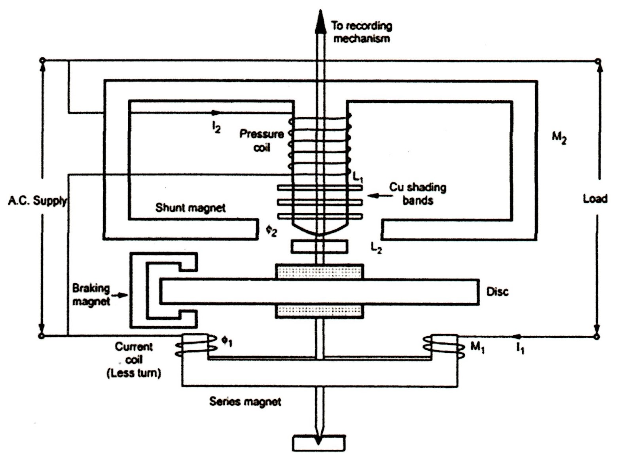

Slide 34
Working:
When the energy meter is connected in the circuit to measure electrical energy, the current coil carries the load current whereas the pressure coil carries current proportional to the supply voltage. The magnetic field due to current coil is in phase with line current whereas the magnetic field produced due to pressure coil lags approximately 90 degrees behind the supply voltage.

Slide 35
The current coil field produces eddy currents in the disc which reacts with the field due to the pressure coil. Thus, a driving force is created which causes the disc to rotate.
The braking magnet provides the braking torque on the disc. By altering the position of this magnet, desired speed can be obtained. The spindle is geared to the recording mechanism so that electrical energy consumed in the circuit is directly registered in kWh.

Slide 36
Theory of Operation

Slide 43
Text Books for EM
David A Bell, Electronic Instrumentation and Measurements, Oxford Press, (2e), 2004.
H S Kalsi, Electronic Instrumentation, MGH education, (2e), 2004.
Helfrick A.D, Cooper W.D, Modern Electronic Instrumentation & Measurement Techniques, PHI, (5e), 2002.

Slide 44
What we are going to study in this lecture?
Advantages of Energy meter
Errors in Energy meter and methods to compensate the error
Calibration of single phase energy meter
Three phase energy meter
Digital energy meter

Slide 45
Advantages of Induction type EM

Slide 46
ERRORS IN ENERGY METER AND METHODS TO COMPENSATE THE ERROR

Slide 47
8.3.3 Errors in Energy meters
The energy measurements by energy meters involve errors owing to many sources and reasons as follows:
Errors in driving system include errors due to incorrect magnitude of flux values, phase angles, etc. and lack of symmetry in magnetic circuit.
Errors in braking system such as changes in the strength of brake magnet, changes in disc resistance, self braking effect of series magnet flux and abnormal friction of the moving parts.
Errors in registering system are also expected to be present since they involve mechanical parts. They are taken care of by calibration of the meter.
Other errors include errors caused due to friction, overloads, phase angle variations, temperature effects, creeping of the meter, etc. These errors are avoided by correct adjustments made using the various compensator facility provided on the meter.

Slide 48
Other Errors
1. Phase Error
2. Speed Error
3. Creeping
4. Temperature Error
5. Error due to voltage variations

Slide 49
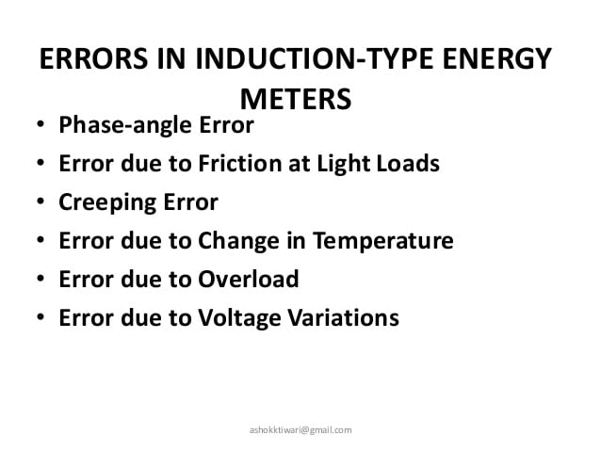

Slide 50
Energy meters should give correct readings over a period of several years under normal use conditions. Some of the common errors in energy meter and their remedial measures are discussed below.
1.Phase Error: It is necessary that the energy meter should give correct reading on all power factors, which is only possible when the field setup by shunt magnet lags behind the applied voltage by 90º. But the flux due to shunt magnet does not lag behind the applied voltage exactly by 90º because of winding resistance and iron losses.
Adjustment: The flux in the shunt magnet can be made to lag behind the supply voltage by exactly 90º by adjusting the position of shading band (or shading ring or shading coil) placed round the lower part of the control limb of the shunt magnet.
This adjustment is known as lag adjustment or power factor adjustment (or power factor compensator).

Slide 51
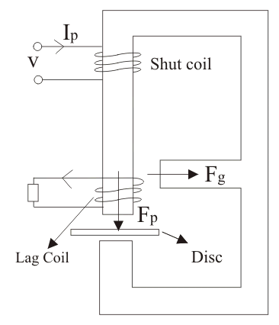

Slide 52
Lag Adjustment devices : They are used to introduce a magnetic shunt circuit which helps to provide an MMF in proper phase relation to bring the pressure coil flux in exact quadrature with the voltage. This is done by using either adjustable resistance or copper shading bands on the shunt magnet as shown in figure 8.2. The copper shading bands are provided on the central limb of the shunt magnet and they are position-adjustable.
They bring the potential coil flux exactly in quadrature with the applied voltage.
Some times the lag plates are also useful for this purpose.

Slide 54
2. Speed Error: Sometimes the speed of the meter is either fast or slow, resulting in the wrong recording of energy consumption.
Adjustment: An error in the speed of the meter when tested on non-inductive load can be eliminated by correctly adjusting the position of the brake magnet.
Movement of the brake magnet in the direction of the spindle will reduce the braking torque and vice-versa.

Slide 55
3. Friction Compensation (or) Friction Error: Frictional forces at the rotor bearings and in the counting (or register) mechanism cause noticeable error especially at light loads. At light loads, the torque due to friction adds considerably to the braking torque on the disc rotor. Since, friction torque is not proportional to the speed but is roughly constant it can cause considerable error in meter reading.
Adjustment: This error can be reduced to an unimportant level by making the ratio of the shunt magnet flux Φ₂ and series magnet flux Φ₁ large with the help of two shading rings (or shading bonds).
These bonds embrace the flux contained in the two outer limb of the shunt magnet and thus eddy currents are induced in them which cause a phase displacement between the enclosed flux and the main gap flux.
As a result, a small driving torque is exerted on the disc rotor, this torque being adjusted by variation of the positions of these bands to compensate for friction in the instrument.
Correctness of friction compensation is achieved by running the meter at high load of about 8 to 10% of full load when the disc should rotate correctly.
Over compensation leads to creep. This adjustment is known as light load adjustment.

Slide 56
Friction or Low load Compensation : The friction errors are serious at
low loads. To ensure proper reading at low loads, friction compensators are used, which provide a small torque, independent of the load. This torque is equal and opposite to the friction torque.
The friction compensator consists of a small shading loop placed between the disc and shunt magnet, slightly towards one side of the disc, as shown in figure 8.2. It is correctly adjusted to ensure minimum friction at low loads.

Slide 57
4. Creeping: Sometimes the disc of the energy meter makes slow but continuous rotation at no load i.e. when the potential coil is excited but with no current flowing in the load. This is called creeping. This error may be caused due to over compensation for friction, excessive supply voltage, vibrations, stray magnetic fields etc.
Adjustment: in order to prevent this creeping on no load, two holes or slots are drilled in the disc on opposite sides of the spindle. This causes sufficient distortion of the field. The result is that the disc tends to remain stationary when one of the holes comes under one of the shunt magnet.

Slide 58
Creeping in Energy Meter
Definition: Creeping in energy meter is the phenomenon in which the aluminium disc rotates continuously when only the voltage is supplied to the pressure coil, and no current flows through the current coil. In other words, the creeping is the kind of error in which the energy meter consumes a very small amount of energy even when no load is attached to the meter.

Slide 59
The creeping increases the speed of the disc even under the light load condition which increases the meter reading. The vibration, stray magnetic field and the extra voltage across the potential coil are also responsible for the creeping.
The creeping error occurs because of the excessive friction. The main driving torque is absent at no load. Hence the disc rotates because of the additional torque provided by the compensating vane.

Slide 60
Creep : In some energy meters, when the pressure coil is energized, a slow, but continuous rotation of the disc is observed even when there is no current in the current coil. This is called Creeping.
This can be due to several reasons such as overcompensation for friction, vibrations, stray field effects and excessive pressure coil voltage.
To prevent creeping, two diametrically opposite holes are drilled on the disc. The disc will stall when one of the holes comes under one of the poles of the shunt magnet.
Thus the rotation is restricted to a maximum of half a revolution.

Slide 61
Prevention of Creeping
The creeping is avoided by drilling the hole in the disc. The holes are diametrically opposite to each other. The aluminium disc stops rotating even when the small edge of the disc come under the pole of the magnet. The holes will limit the revolution of the disc.
This action can easily be understood by considering the figure shown below.

Slide 62
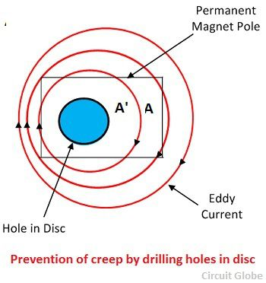

Slide 63
The circular eddy current path of the disc will disturb when the hole comes under the pole of the magnet. The A’ is the centre point of the magnetic pole which is produced by the current. The force acting on the disc will move the centre point A’ away from the poles axis A.
The disc will rotate at no load until the holes reach under the edges of the magnet. Their movement is opposed by the torque produced in this condition.
In some cases, the small piece of iron is attached to the edge of the disc. The force of attraction occurs between the pole magnets and the iron piece, which prevent the creeping of the disc.

Slide 64
5. Temperature Error: The error due to variation in temperature are very small, because the various effects produced tend to neutralise one another.
The resistance of the disc of the potential coil and characteristics of magnetic circuit and the strength of break magnet are affected by the changes in temperature. Therefore, great care is exercised in the design of the meter to eliminate the errors due to temperature variations.
Temperature Compensation : Owing to temperature effects, the energy meters may runs faster and register wrong values. In such cases, the compensation is provided by a temperature shunt on the brake magnet.

Slide 65
Voltage Compensation : The errors due to voltage variations are compensated by increasing the reluctance of side limbs of shunt magnet.
Holes are provided on the side limbs of shunt magnet for this purpose.
Voltage Variations: The error due to variation in voltage is very small (usually 0.2% to 0.3%). This can be eliminated by the proper design of the magnetic circuit of the shunt magnet.

Slide 66
Over load Compensation : Over load compensators are used to minimize the self braking action of energy meters. They are in the form of a saturable magnetic shunt for the series magnet.
Under load conditions the disc continuously moves. Therefore there induced an emf which is due to rotation called dynamically induced emf. Due to this emf the eddy currents are produced which interacts with the series magnetic field to produce breaking torque.
Now this breaking torque is directly proportional to square of current hence it continuously increases and opposes the rotation of disc.
In order to avoid the production of this self breaking torque, the full load speed of disc is kept as low as possible so that self breaking torque can be reduced. Errors in single phase energy meters:

Slide 67
Over load compensation
Under load conditions the disc continuously moves. Therefore there induced an emf which is due to rotation called dynamically induced emf. Due to this emf the eddy currents are produced which interacts with the series magnetic field to produce breaking torque. Now this breaking torque is directly proportional to square of current hence it continuously increases and opposes the rotation of disc. In order to avoid the production of this self breaking torque, the full load speed of disc is kept as low as possible so that self breaking torque can be reduced. Errors in single phase energy meters: The errors caused by both the system (i.e. driving and braking) are separating written as follows:

Slide 68
Error caused by Driving System
Error Due to Non SymmetricalMagnetic Circuit If the magnetic circuit is not symmetrical there produce a driving torque, due to which meter creep.
Error Due to Wrong Phase Angle If there is not a proper phase difference between the various phasors then it results in improper rotation of disc. Improper phase angle is due to improper lag adjustment, variation of resistance with temperature or it may be due to abnormal frequency of supply voltage.
Error Due to Wrong Magnitude of Fluxes There are several reasons for wrong magnitude of fluxes out of these main reasons are abnormal values of current and voltage.

Slide 69
Frequency Variations: The meter is designed to give minimum error at a particular frequency (generally 50 Hz). If the supply frequency changes, the reactance of the coils also changes, resulting in a small error. Fortunately, this is not of much significance because commercial frequencies are held within close limits.

Slide 73
Adjustments in single phase energy meter
1. preliminary light load adjustments
2.Full load u.p.f adjustment
3. Low p.f adjustment
4.Light load adjustment
5.Creep adjustment

Slide 78
Class 3
What we are going to study in this lecture is
Calibration of Energy Meter
3 phase Energy Meter
Digital Energy Meter

Slide 86
The percentage errors in disc speed, time taken for given number of rotations or wattage consumption can also be similarly determined. It is to be noted that the accuracy of calibration depends on the accuracy with which the wattage is measured using a standard wattmeter.
It is also needful to ensure the accuracy of the stop clock used for time measurements. Finally a calibration curve can be drawn as a plot of the percentage error on the y- axis and indicated energy reading- IRE or ammeter reading- I on the x- axis as shown in figure 8.6.
It should be observed that the different points so obtained are joined using straight lines to get the complete calibration curve.

Slide 87
The use of calibration curves are obvious. Whenever an already calibrated meter is used for measurements, the reading shown by the meter can be converted to its true value by using the calibration curve.
The meter is usually adjusted to read within ± 0.5 % of the correct registration.

Slide 103
Exercises

Slide 104
Three Phase Energy Meter
Definition:
The meter which is used for measuring the power of three phase supply is known as the three phase energy meter.
The three phase meter is constructed by connecting the two single phase meter through the shaft.
The total energy is the sum of the reading of both the elements.

Slide 105
3 phase energy meter
8.4.1 Introduction
It is well established that for measurement of total power or energy in a n- conductor system, it is required to use a meter with (n-1) elements.
The principle of single phase energy meter can as well be extended to obtain a poly-phase energy meter, in particular a three phase energy meter. Usually, a three phase energy meter is available as a 2-element meter or 3-element meter, each element being similar in construction to the single phase meter and all elements mounted on a common shaft.
The torque developed by each element is summed up mechanically and the total number of revolutions made by the shaft is proportional to the total three phase energy consumption.

Slide 108
8.4.2 Construction, Operation and Testing
In a two-element, three phase energy meter the two discs are mounted on a common spindle and each disc has its own brake magnet.
The moving system drives a single gear train. Each unit is provided with its own copper shading ring, shading band, friction compensator, etc., for adjustments to be made to obtain the correct reading

Slide 109
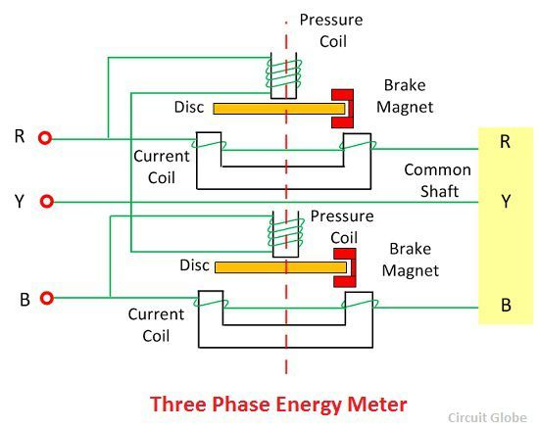

Slide 111
A two element energy meter used for three phase energy measurements in three phase three wire systems, is schematically shown in figure 8.7.
It is needful that for the same power/ energy, the driving torque should be equal in the two elements. This is checked by torque adjustment.
For torque adjustment, the two current coils are connected in series opposition and the two potential coils are connected in parallel.
Full load current is allowed to pass through the current coil. This set up causes the two torques to be in opposition and so, if the torques are equal, then the disc should not move.

Slide 112
If there is any slight motion indicating inequality of the two torques, then the magnetic shunt is adjusted until the disc stalls.
Thus the torque balancing is obtained before testing the meter.
The friction compensator and brake magnet positions are adjusted to each of the two/three elements separately, treating each of them as a single phase element on single phase AC supply.
The calibration of three phase meter can also be performed in a similar manner, as that described earlier, for single phase energy meters.

Slide 113
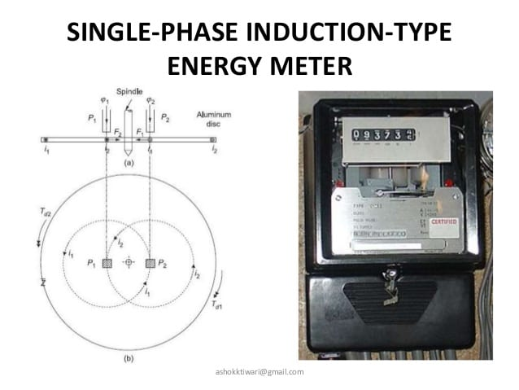

Slide 114
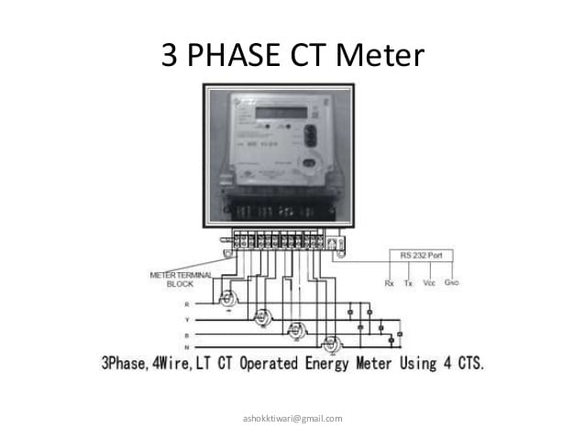

Slide 115
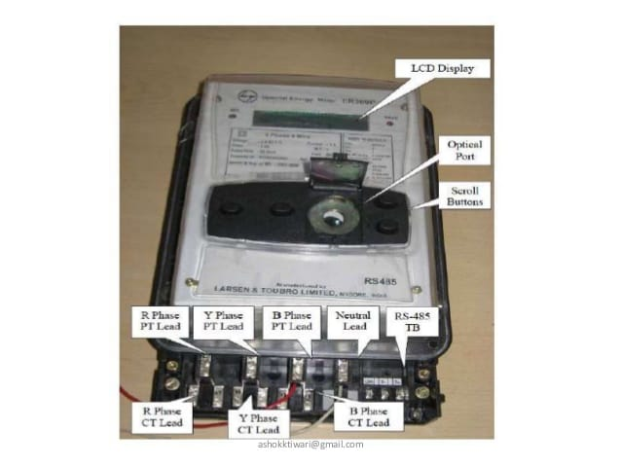

Slide 116
Types w.r.t Construction
According to construction energy meter classified into three types which are given below.
1. Electromechanical induction type
2. Electronic Energy Meter
3. Smart Energy Meter

Slide 117
ELECTRONIC ENERGY METERS OR DIGITAL ENERGY METERS
With the use of conventional Ferraris type induction watt hour meters at the consumer premises for tariff purposes, the supply undertakings as well as consumers are put to many disadvantages:
The supply undertakings are at a loss when the meters do not properly record the energy values. This could be due to many reasons such as meter tampering, meters exposed to different atmospheric disturbances and delay in resetting.
In cases where the meters record readings with a positive error i.e., the meter records the energy value higher than that consumed by the circuit in which it is connected for metering purposes, then the consumer is expected to pay more for the energy consumed than what he really is supposed to

Slide 118
Besides the above problems faced with malfunctioning of energy meters causing wrong billing, these meters fail to record the effect of leakage currents, harmonics in supply waveforms, etc.
It is not justifiable to charge the consumer for the harmonic energy, passing through the meter, for which both the consumer and utilities are equally responsible. Besides, this energy is not at all generated by the utilities.
Recently, the interest is towards using the digital methods for energy metering purposes. The electronic energy meter is one such method adopted by most of the utilities.
Although the requirements of accuracy in energy meters is still debatable, the hue and cry about the installation of electronic energy meters can be defended with a list of their advantages as under:

Slide 119
Advantages
Simple in construction & reliable.
• Very accurate compared to conventional energy meters.
They start measuring instantaneously when connected to the load.
• Friction and magnetic leakage errors are absent since they are disc-less meters.
• Tampering of meters is not possible at the consumer end.
• Maintenance-free in operation.
• Can record even the small leakage currents, thus raising the bill amounts.

Slide 120
ENERGY TARIFF
Different Tariff schemes have been evolved as a means for realizing a balance between costs of power production, transmission & distribution with the cost recovered through bills from the different consumers on the supply network.
Different tariff methods are adopted depending on the type of consumer.
The total charges are divided mainly in to the following two categories:

Slide 121
Fixed Charges: The maximum demand to be simultaneously met with, fixes the rating of a generating plant. In other words, a fixed amount is spent for the given plant in proportion to its maximum demand requirement.
Such expenses include the cost of plant, buildings, transmission and distribution equipment, etc. This part is referred as Fixed Charges.
Running Charges: The expenses made on fuel, salaries to employees, maintenance, etc., depend on the current load and hence the total number of generated units of energy by the system. This part is referred as Running charges.

Slide 122
Thus the consumer has to be charged in such a way that the total cost of electric generation and supply of power is equitably shared by all types of consumers in proportion to their respective maximum demand.
This should be in addition to the charge to be borne by them for their total energy consumption. In AC systems, the power factor also plays a very important role. A low power factor (LPF) causes many disadvantages, especially from the supply authorities view point, as listed below
Consumers with LPF loads require a much larger current for a given amount of active power, than would be necessary if their PF is high.

Slide 123
The increased current requirements at LPF necessitate the use, in the power station, of generators of a correspondingly high current capacity.
LPF results in poor voltage regulation.
LPF causes the copper losses in machines and distribution lines to be high.
In effect, LPF results in increased running changes to the utilities

Slide 124
Thus, it is reasonable that a consumer, especially the industrial establishments, should be charged extra to compensate for the increase in costs for which their LPF is responsible.
The tariff should be such that the consumers maintaining good power factor values, up to unity, should be encouraged to do so and those who do not maintain good power factor should be charged extra.
Various tariff schemes have been used in practice by the supply undertakings. Some of the very common schemes are as follows:

Slide 125
KWh or Flat Rate Tariff : This involves charging the consumer in proportion to the KWh of energy consumed by him.
MD or Two- Part Tariff : Here, the total charge includes two parts: the first part is the fixed charges based on the maximum demand and the second part is the running charges based on the KWh of energy consumed. The maximum demand is the average power over 20 – 30 minutes of predetermined period.
PF or Three- Part Tariff : This is followed mainly to encourage consumers to maintain a high power factor. Here, the total charge includes three parts: the
first part is the fixed charges based on the maximum demand, the second and third parts are the running charges based on the KWh and KVArh of energy consumption.

Slide 126
Electronic Energy Meter
Electronic meters display the energy used on an LCD or LED display, and some can also transmit readings to remote places. In addition to measuring energy used, electronic meters can also record other parameters of the load and supply such as instantaneous and maximum rate of usage demands, voltages, power factor and reactive power used etc.
They can also support time-of-day billing, for example, recording the amount of energy used during on-peak and off-peak hours.

Slide 127
These are of accurate, high procession and reliable types of measuring instruments as compared to conventional mechanical meters. It consumes less power and starts measuring instantaneously when connected to load. These meters might be analog or digital. In analog meters, power is converted to proportional frequency or pulse rate and it is integrated by counters placed inside it.
In digital electric meter power is directly measured by high end processor. The power is integrated by logic circuits to get the energy and also for testing and calibration purpose. It is then converted to frequency or pulse rate.

Slide 128
Digital Electronic Energy Meter:
Digital signal processor or high performance microprocessors are used in digital electric meters.
Similar to the analog meters, voltage and current transducers are connected to a high resolution ADC. Once it converts analog signals to digital samples, voltage and current samples are multiplied and integrated by digital circuits to measure the energy consumed.

Slide 129
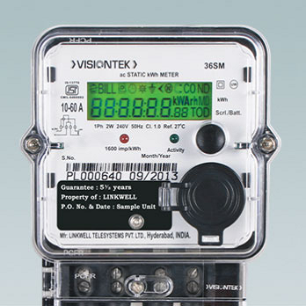

Slide 130
Microprocessor also calculates phase angle between voltage and current, so that it also measures and indicates reactive power. It is programmed in such a way that it calculates energy according to the tariff and other parameters like power factor, maximum demand, etc and stores all these values in a non volatile memory EEPROM.
It contains real time clock (RTC) for calculating time for power integration, maximum demand calculations and also date and time stamps for particular parameters. Furthermore it interacts with liquid crystal display (LCD), communication devices and other meter outputs. Battery is provided for RTC and other significant peripherals for backup power.

Slide 131
Digital Energy Meter
Generally, electricity meters operate by continuously measuring the instantaneous voltage (volts) and current (amperes) and finding the product of these to give instantaneous electrical power (watts) which is then integrated against time to give energy used (Joules, Kilowatt-hours etc.).
Meters for smaller services (such as small residential customers) can be connected directly in-line between source and customer. For larger loads, more than about 200 amps of load, current transformers are used, so that the meter can be located other than in line with the service conductors [2]. The meters fall into two basic categories, electromechanical and electronic

Slide 132
Digital Energy Meter
Digital Energy meters display the energy used on an LCD or LED display, and some can also transmit readings to remote places. They can also support time-of-day billing, for example, recording the amount of energy used during on-peak and off-peak hours.
As shown in the block diagram below, the meter has a power supply, a metering engine, a processing and communication engine (i.e. a microcontroller), and other add-on modules such as RTC, LCD display, communication ports/modules and so on.

Slide 134
The metering engine is given the voltage and current inputs and has a voltage reference, followed by an ADC section (samplers and quantisers) to yield the digitised equivalents of all the inputs. These inputs are then processed using a digital signal processor to calculate the various metering parameters such as powers, energies etc.
The processing and communication section has the responsibility of calculating the various derived quantities from the digital values generated by the metering engine. This also has the responsibility of communication using various protocols and interface with other addon modules connected as slaves to it.

Slide 135
RTC and other add-on modules are attached as slaves to the processing and communication section for various input/output functions. On a modern meter most if not all of this will be implemented inside the microprocessor, such as the real time clock (RTC), LCD controller, temperature sensor, memory and analog to digital converters.
The single phase energy meter circuit has two current transformers connected in series with each supply line: phase and neutral. The current values from these transformers are sent to the respective ADC of the microcontroller, and then the ADC converts these values to digital values, and thus the microcontroller does necessary calculations to find the energy consumption.
The Microcontroller is programmed in such a way that the voltage and current values from the ADC are multiplied and integrated over a specified time period, and then correspondingly drive the counter mechanism that displays the number of units consumed (kWh) over a time period.

Slide 136
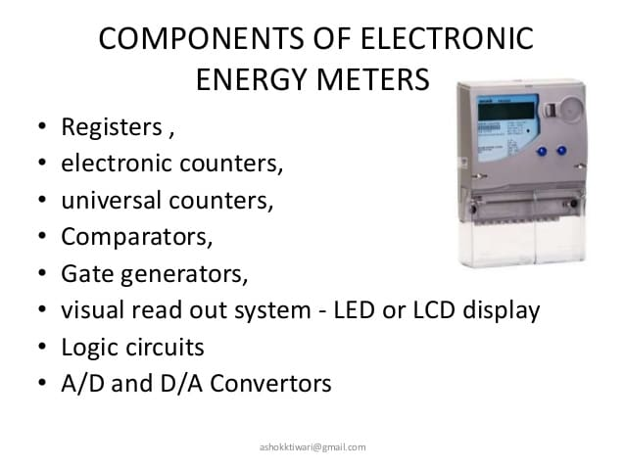

Slide 137
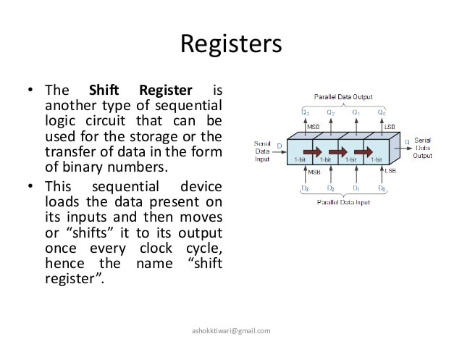

Slide 138
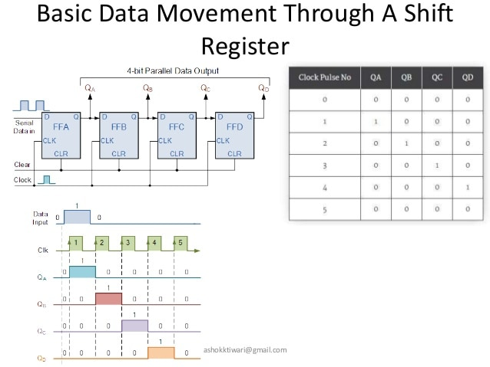

Slide 139
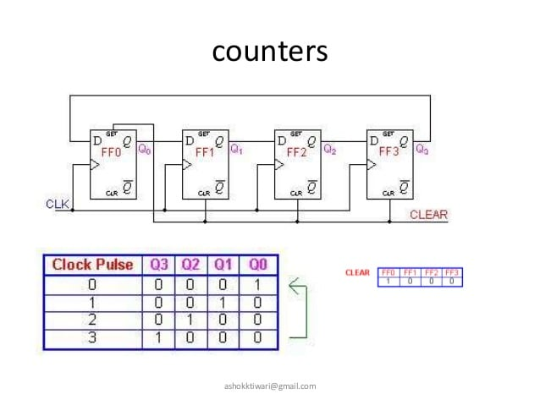

Slide 140
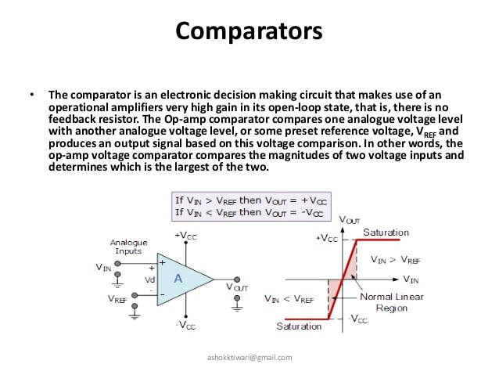

Slide 141
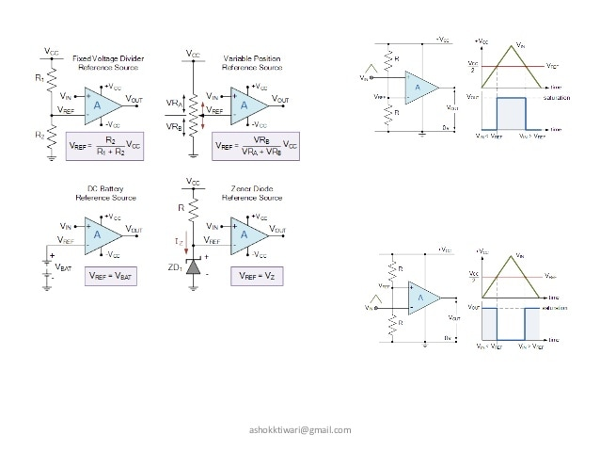

Slide 142
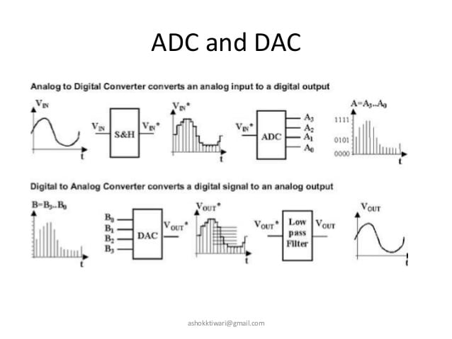

Slide 143
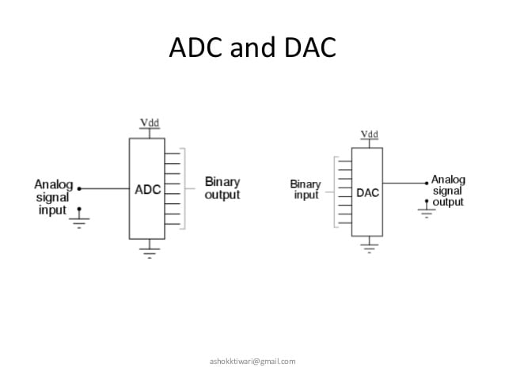

Slide 144
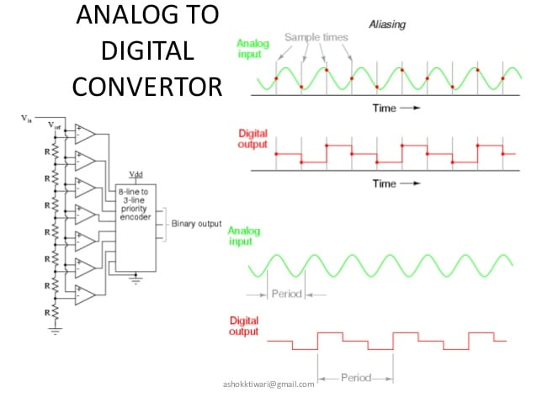

Slide 145
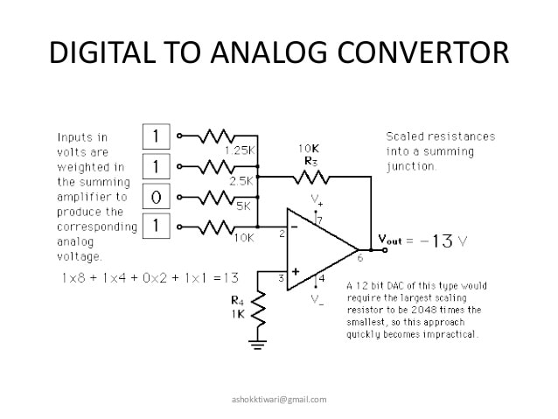

Slide 146
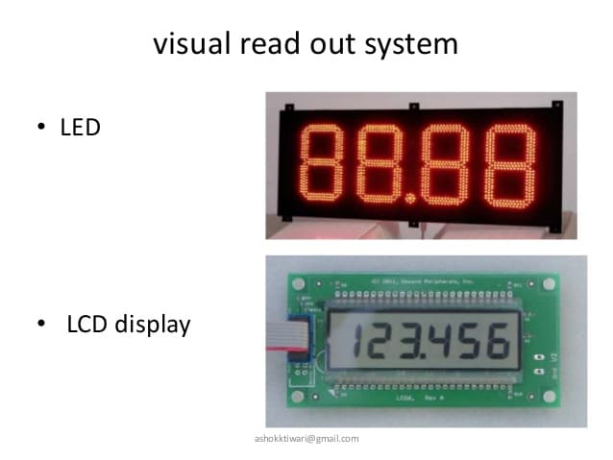

Slide 147
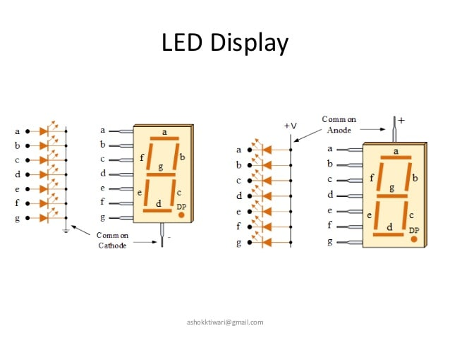

Slide 148
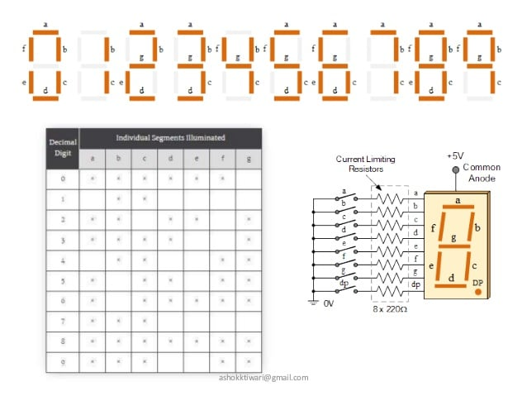

Slide 149
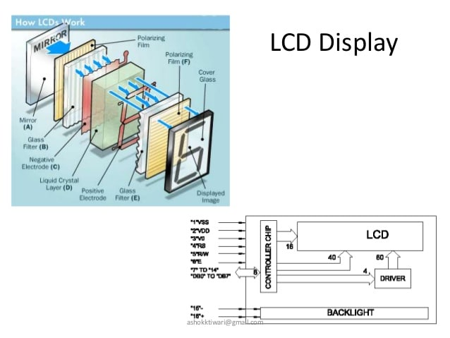

Slide 150
It reduces the cost of theft and corruption on electricity distribution network with electronic designs and prepayment interfaces.
In addition to the energy measurement, this system also provides earth fault indication in case of any fault or overcurrent that may occur in neutral or earth line and appropriately turns the Light Emitting Diodes indication for earth fault detection as well as for every unit consumption.

Slide 151
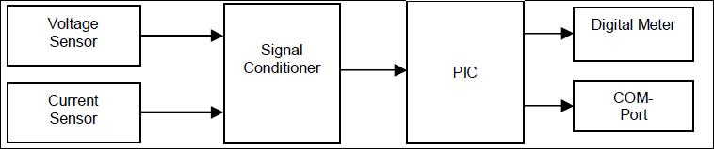

Slide 152
The block diagram for a digital meter. Here, two basic sensors are employed. These are voltage and current sensors.
The voltage sensor built around a step down element and potential divider network senses both the phase voltage and load voltage. The second sensor is a current sensor; this senses the current drawn by the load at any point in time. It is built around a current transformer and other active devices (such as voltage comparator) which convert the sensed current to voltage for processing.
The output from both sensors is then fed into a signal (or voltage) conditioner which ensures matched voltage or signal level to the control circuit, it also contain a signal multiplexer which enable sequential switching of both signal to the analogue input of the peripheral interface controller (PIC). The control circuit centered on a PIC integrated circuit. The PIC is selected because it contain ten bit analogue to digital converter (ADC), very flexible to program and good for peripheral interfacing.

Slide 153
The ADC converts the analogue signals to its digital equivalent; both signals from the voltage and current sensors are then multiplied by the means of embedded software in the PIC.
Here the error correction is taken as the offset correction by determining the value of the input quality with short-circuited input and storing this value in the memory for use as the correction value device calibration.
The PIC is programmed in C language. Such that apart from the multiplier circuit it simulates, it is able to use the received data to calculate power consumption per hour, as well as the expected charges. These are displayed on the liquid crystal display attached to the circuit

Slide 154
Smart Energy Meter
A smart meter is an electronic device that records consumption of electric energy and communicates the information to the electricity supplier for monitoring and billing. Smart meters typically record energy hourly or more frequently, and report at least daily.
Smart meters enable two-way communication between the meter and the central system. Such an advanced metering infrastructure (AMI) differs from automatic meter reading (AMR) in that it enables two-way communication between the meter and the supplier. Communications from the meter to the network may be wireless, or via fixed wired connections such as power line carrier (PLC). Wireless communication options in common use include cellular communications (which can be expensive), Wi-Fi (readily

Slide 155
available), wireless ad hoc networks over Wi-Fi, wireless mesh networks, low power long range wireless (LoRa), ZigBee (low power, low data rate wireless), and Wi-SUN (Smart Utility Networks).
It is an advanced metering technology involving placing intelligent meters to read, process and feedback the data to customers. It measures energy consumption, remotely switches the supply to customers and remotely controls the maximum electricity consumption. Smart metering system uses the advanced metering infrastructure system technology for better performance.

Slide 156
